Slide 1

Multi-Agent Architecture Johnson & Johnson

Slide 2
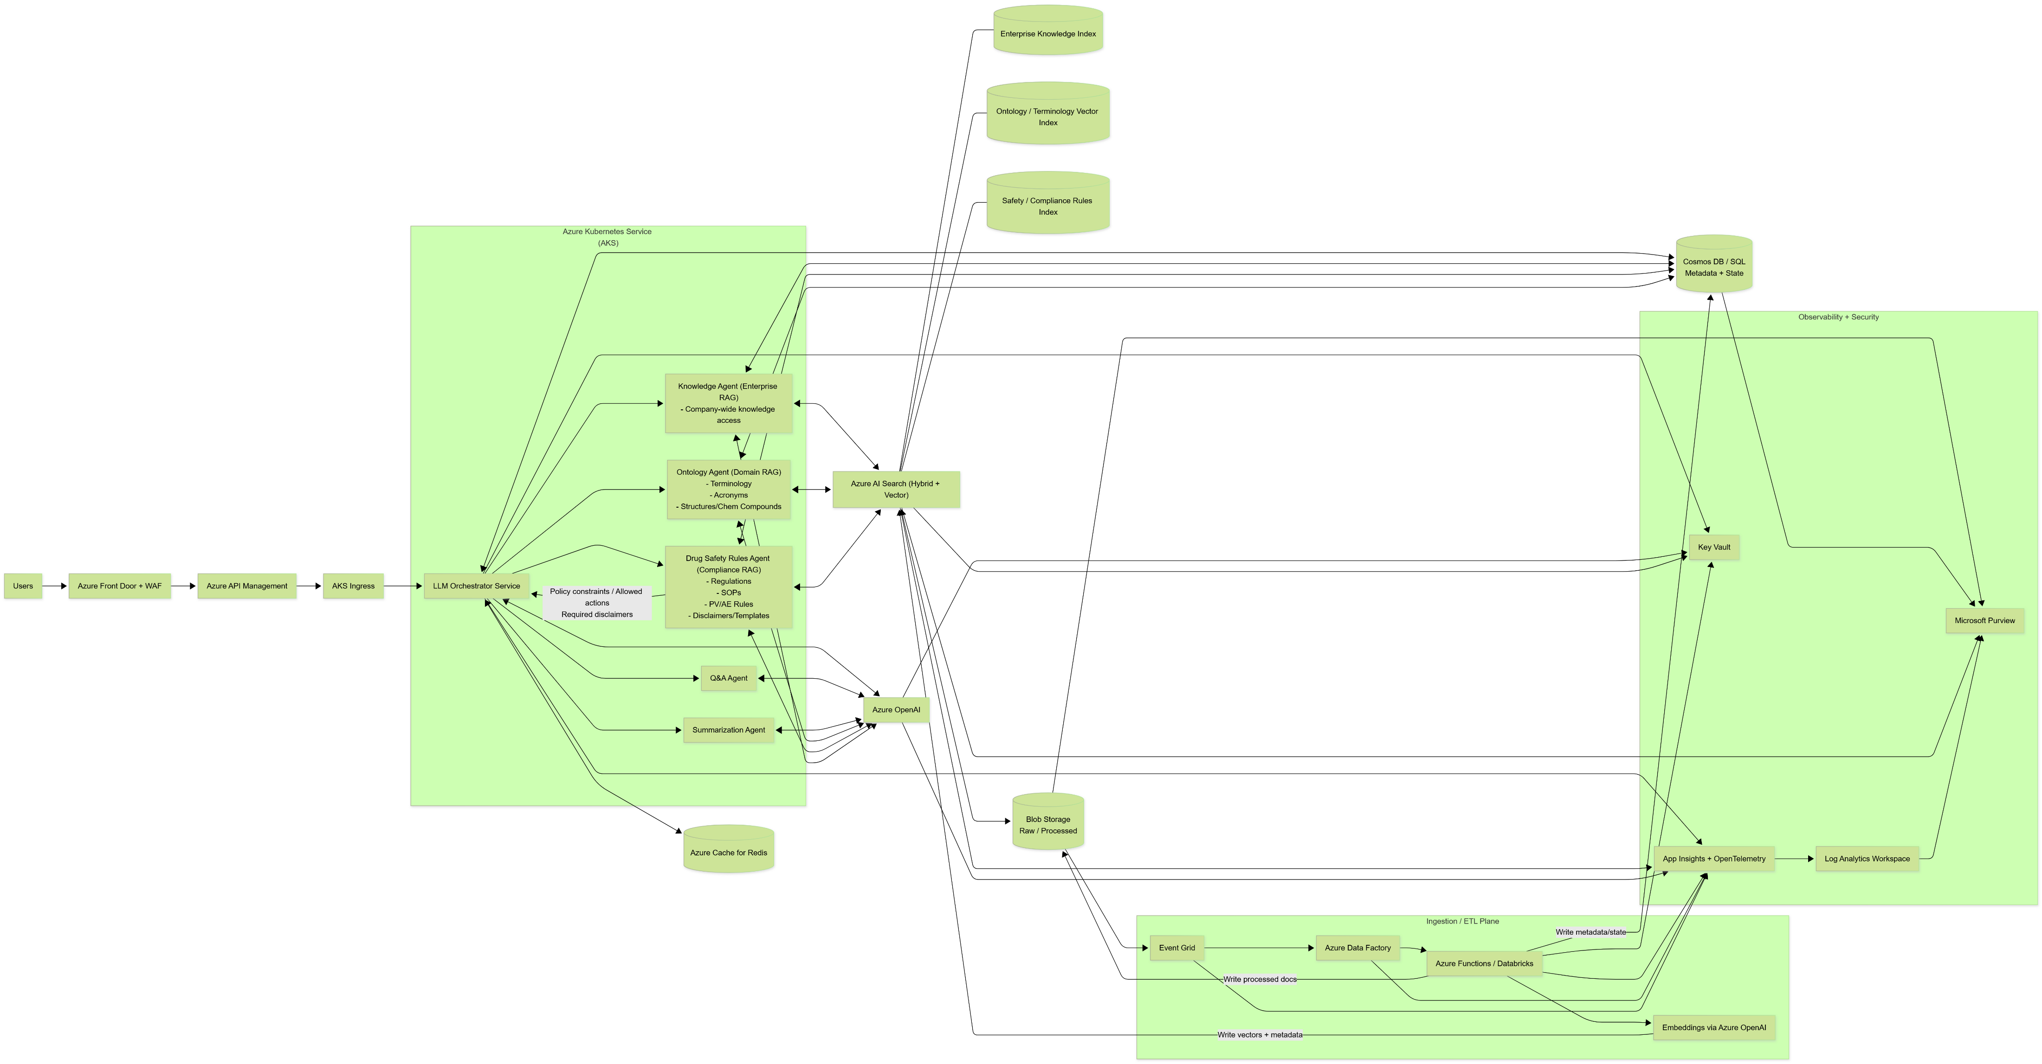

Slide 3

Azure Front Door + WAF
Azure Front Door provides global routing and acceleration, while WAF enforces application-layer security before any request reaches our AI services.”
What it actually does:
Routes users to the closest and healthiest region
Terminates TLS (SSL) once, cleanly
Provides global load balancing
Accelerates responses via Microsoft’s edge network

Slide 4
Azure API Management
Azure API Management (APIM) is the front desk and rulebook for your APIs.
What it does:
Exposes your backend APIs through one controlled gateway
Enforces authentication & authorization (OAuth, JWT, keys)
Applies rate limits, quotas, and throttling
Validates requests and responses
Logs and monitors API usage
Why it matters in your AI architecture:
Protects your LLM and agent endpoints from abuse
Prevents one user from DDoS’ing your token budget
Lets you change backend services without breaking clients
One-liner you can reuse:
“Azure API Management acts as a secure, policy-driven gateway that controls access, throttling, and governance for all AI-facing APIs before they reach AKS.”

Slide 5

AKS Ingress
AKS Ingress is the traffic router inside your Kubernetes cluster.
What it does:
Receives HTTP/HTTPS traffic from API Management or Front Door
Routes requests to the correct Kubernetes service or pod
Handles path-based and host-based routing
Terminates TLS inside the cluster (if not already done upstream)
Why it matters in your AI setup:
Directs requests to the right agent service (Orchestrator, RAG agents, etc.)
Keeps services private and decoupled
Lets you add, scale, or replace agents without changing external endpoints
One-liner you can reuse:
“AKS Ingress controls internal HTTP routing, directing external traffic to the appropriate microservices running inside the Kubernetes cluster.”
Think of it as the GPS once traffic is already inside the building.

Slide 6

Azure Kubernetes Service
Azure Kubernetes Service (AKS) is a managed platform for running containerized applications at scale.
What it does:
Runs your microservices (LLM orchestrator, agents, ingestion jobs) in containers
Handles auto-scaling, self-healing, and rolling deployments
Integrates tightly with Azure networking, security, and monitoring
Offloads Kubernetes control-plane management to Azure
Why it matters in your AI architecture:
Lets you scale agents independently (Ontology, Rules, Knowledge)
Supports high availability and zero-downtime updates
Provides production-grade isolation and reliability for AI workloads
One-liner you can reuse:
“AKS provides a managed Kubernetes environment to run and scale AI microservices reliably without managing the underlying cluster infrastructure.”
Basically: it’s the engine room where all your agents live.

Slide 7
LLM Orchestrator Service
LLM Orchestrator Service — what it is
The LLM Orchestrator Service is the central control plane that decides how a user request is handled, which agents are invoked, and in what order—before anything ever reaches the LLM.
It does not just call a model. It manages the entire reasoning workflow.
What it does (in plain English)
When a request comes in, the orchestrator:
Classifies intent (Q&A, summarization, safety-sensitive, terminology-heavy, etc.)
Selects the right agents (Ontology, Drug Safety Rules, Knowledge, Q&A)
Enforces ordering (e.g., rules before generation)
Aggregates retrieved context
Applies policy constraints and guardrails
Calls Azure OpenAI with a grounded, structured prompt
Returns a compliant, traceable response
Think of it as traffic control for intelligence.

Slide 8
Azure Cache for Redis
Azure Cache for Redis is a high-speed, in-memory data store used to keep frequently accessed data so your system doesn’t have to recompute or re-fetch it every time.
Provided by Microsoft Azure, it’s basically RAM with superpowers.
What it does:
Stores data in memory for microsecond-level access
Handles session state, request context, and intermediate results
Reduces repeated calls to databases, vector search, or LLMs
Why it matters in your LLM orchestration architecture:
Caches agent decisions, routing results, and conversation state
Prevents re-running the same ontology or rules checks
Helps control latency and token costs
Enables scalable, stateless agent services in AKS
One-liner you can reuse:
“Azure Cache for Redis provides low-latency, in-memory caching for session state and intermediate results, improving performance and scalability of LLM-driven workflows.”

Slide 9

Azure Open AI
Azure OpenAI Service is a managed, secure way to run OpenAI models inside your Azure environment.
Offered by Microsoft Azure, it gives you access to GPT models, embeddings, and chat completions without sending data outside your tenant.
What it does:
Hosts large language models (GPT-4-class, embeddings, etc.)
Generates text, summaries, reasoning, and embeddings
Integrates natively with Azure networking, identity, and monitoring
Why it matters in your architecture:
Keeps sensitive pharma/enterprise data private and compliant
Supports RAG workflows (embeddings + generation)
Enables logging, auditing, and access control
Works cleanly with AKS, AI Search, and APIM
“Azure OpenAI provides secure, enterprise-grade access to large language models within Azure, enabling compliant generation and embedding for AI applications.”

Slide 10

Azure AI Search (Hybrid + Vector)
Azure AI Search (Hybrid + Vector) is a retrieval engine that combines keyword search and semantic vector search to find the most relevant information for LLMs.
What it does:
Uses keyword/BM25 search for exact terms and filters
Uses vector search for semantic similarity
Merges both results into a single ranked response (hybrid)
Stores embeddings plus metadata for grounding LLM outputs
Why it matters in your RAG architecture:
Enables accurate, low-hallucination retrieval
Supports multiple indexes (knowledge, ontology, compliance)
Allows filtering by metadata (source, date, access level)
Feeds precise context into Azure OpenAI
One-liner you can reuse:
“Azure AI Search enables hybrid keyword and vector retrieval, providing accurate, semantically grounded context for RAG-based LLM applications.”

Slide 11
How the Ingestion / ETL Plane works (step by step)
Blob Storage (Raw) This is the landing zone. PDFs, regulations, SOPs, drug labels, and source files are stored as-is—no cleaning, no transformation yet.
Event Grid Event Grid is the tripwire. The moment a new file lands in Raw Blob Storage, it emits an event saying, “Hey, new data just arrived.”
Azure Data Factory (ADF) ADF is the orchestrator of data movement. It listens for Event Grid triggers and:
Moves data through the pipeline
Handles scheduling, retries, and dependencies
Decides which processing path to follow (ontology, compliance, general knowledge)
Azure Functions / Databricks This is the processing brain:
Cleans and normalizes text
Chunks documents
Extracts metadata (source, type, version)
Separates content into ontology, compliance, or knowledge streams
Outputs:
Clean files → Blob Storage (Processed)
Metadata → Cosmos DB / SQL
Embeddings via Azure OpenAI Processed text is converted into vector embeddings. These vectors represent semantic meaning and are written to Azure AI Search indexes for retrieval.

Slide 12

How the Observability + Security Plane Works
Azure Key Vault Key Vault is your vault of secrets. It securely stores API keys, connection strings, certificates, and model credentials so nothing sensitive is hard-coded or exposed to services accessing Blob Storage or downstream systems.
App Insights + OpenTelemetry This is your real-time visibility layer. It traces requests end-to-end—from ingestion, to agents, to LLM calls—capturing latency, failures, dependencies, and custom metrics across the pipeline.
Log Analytics Workspace This is the central log warehouse. All logs, metrics, and traces from ingestion jobs, storage access, agents, and LLM calls land here for querying, auditing, and alerting.
Microsoft Purview Purview is your data governance and compliance brain. It scans Blob Storage (Raw and Processed), tracks lineage, classifies sensitive data, and enforces policies like retention, access control, and regulatory compliance.
How Blob Storage fits in
Raw Blob Storage: monitored, classified, and governed by Purview
Processed Blob Storage: lineage tracked from raw → processed → embedded
All access is logged, audited, and observable end-to-end

Slide 13

Key Vault
Purpose: Centralized secrets management and cryptographic key storage
Functions:
Stores API keys, connection strings, and certificates securely
Manages encryption keys for data at rest and in transit
Provides access control with managed identities
Enables secrets rotation and versioning
Integrates with all Azure services requiring credentials

Slide 14
Entra ID (formerly Azure Active Directory)
Purpose: Identity and access management
Functions:
Authenticates users and service principals
Enforces role-based access control (RBAC)
Manages multi-factor authentication (MFA)
Provides conditional access policies
Enables single sign-on (SSO) across services
Manages service-to-service authentication via managed identities

Slide 15

Microsoft Purview
Purpose: Unified data governance and compliance
Functions: Data cataloging and discovery across the multi-agent system
Data lineage tracking (from ingestion through to output)
Compliance scanning and classification (PII, PHI, sensitive data)
Data quality monitoring and validation
Policy enforcement for data retention and access
Audit trails for regulatory compliance (GDPR, HIPAA, etc.)

Slide 16

App Insights + OpenTelemetry
Purpose: Application performance monitoring and distributed tracing
Functions: Tracks request/response times across all agents
Monitors LLM API calls and token usage
Distributed tracing of multi-agent workflows
Exception tracking and error analysis
Custom metrics for agent performance
Real-time telemetry collection using OpenTelemetry standards
Correlation IDs for end-to-end transaction tracking

Slide 17

Azure Monitor
Purpose: Comprehensive monitoring and alerting platform
Functions: Aggregates logs from all components
Infrastructure monitoring (CPU, memory, network)
Custom alerts and notifications
Dashboards for system health visualization
Metric aggregation from all Azure resources
Integration with Log Analytics for querying
Workbooks for advanced analytics and reporting
Auto-scaling triggers based on metrics

Slide 18
What Cosmos DB/SQL does?
Cosmos DB / Azure SQL (Metadata + State) acts as the system memory and control ledger for your AI platform.
What it stores:
Metadata: document source, version, ingestion time, index location, access level
State: conversation context, agent decisions, workflow status, request IDs
Audit info: which agent accessed what data and when
Why it matters in your architecture:
Enables traceability and reproducibility
Keeps agents stateless and scalable in AKS
Supports retries, rollbacks, and long-running workflows
Separates control data from raw knowledge content
One-liner you can reuse:
“Cosmos DB or Azure SQL stores metadata and execution state, providing durable memory, traceability, and workflow control for the AI system.”

Slide 19
Overall Process
From the moment a user submits a request, Azure Front Door with WAF is the global entry point. Front Door handles global routing and performance, while WAF blocks malicious or malformed requests before they ever touch your platform. Only clean, compliant traffic gets through.
That traffic flows into Azure API Management, which acts as the policy gatekeeper. APIM authenticates the caller, enforces rate limits and quotas, applies API policies, and exposes a stable contract to clients—so your backend can evolve without breaking consumers.
Next, the request enters AKS Ingress, which routes it inside the Kubernetes cluster to the correct service. From there, the LLM Orchestrator Service takes over. This is the brain of the system. It classifies intent, evaluates risk, decides which agents are needed, and enforces execution order—especially calling the Drug Safety Rules Agent before any generation when safety is involved.
Inside AKS, agents are modular and specialized:
The Ontology Agent retrieves terminology, acronyms, and chemical structures from its dedicated vector index.
The Drug Safety Rules Agent retrieves regulatory and compliance rules and returns policy constraints.
The Knowledge Agent retrieves enterprise-wide context across company knowledge.
All retrieval is powered by Azure AI Search (Hybrid + Vector), which blends keyword precision with semantic vector similarity. This ensures the LLM is grounded in the right content, not guessing.
Once context is assembled and constraints are applied, the orchestrator calls Azure OpenAI, which generates responses securely inside your Azure tenant. No data leaves your boundary, and every generation is grounded, auditable, and compliant.
To keep performance tight and costs sane, Azure Cache for Redis stores short-lived state—conversation context, routing decisions, and repeated lookups—so agents don’t redo work unnecessarily. Longer-term state and metadata live in Cosmos DB / Azure SQL, giving you durable memory, traceability, and replayability.
On the data side, knowledge enters the system through the Ingestion / ETL Plane. Raw files land in Blob Storage (Raw). Event Grid detects new data, Azure Data Factory orchestrates ingestion, Azure Functions or Databricks clean and chunk content, and Azure OpenAI embeddings convert it into vectors stored in Azure AI Search. Processed artifacts land in Blob Storage (Processed) with full lineage.
Across everything, the Observability + Security Plane keeps you safe and sane:
Key Vault secures secrets and credentials
App Insights + OpenTelemetry trace requests end to end
Log Analytics Workspace centralizes logs and metrics
Microsoft Purview governs data in Blob Storage, tracking lineage, sensitivity, and compliance

Slide 20

The End

